Slide 1
Auger 3D cylindrical

Slide 2
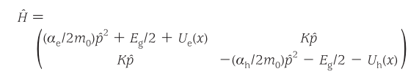
2 band K.P Hamiltonian
Suppression of Auger Processes in Confined Structures
George E. Cragg, Alexander L. Efros

Slide 3
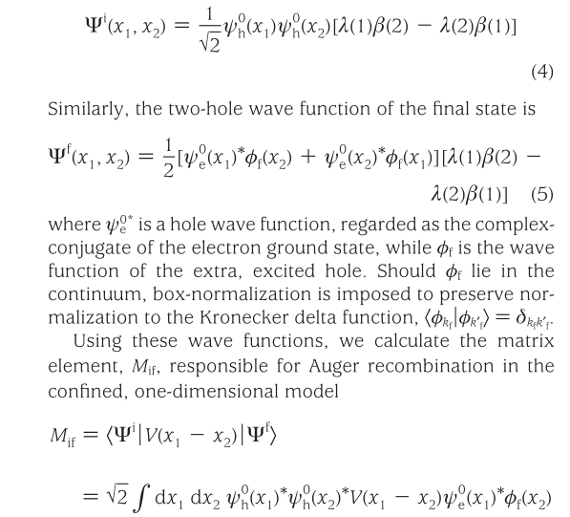


Slide 4
1
2
3

Slide 5
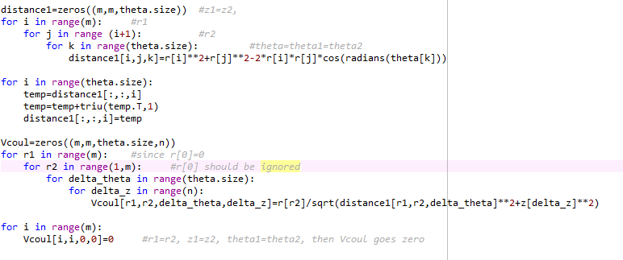
r1, r2, Δ theta, Δz의 함수→ V_{coul}
For integral, rdrdθdz 이니깐 r 미리 곱함
ρ1= ρ2이면 divergence, → Vcoul=0

Slide 6
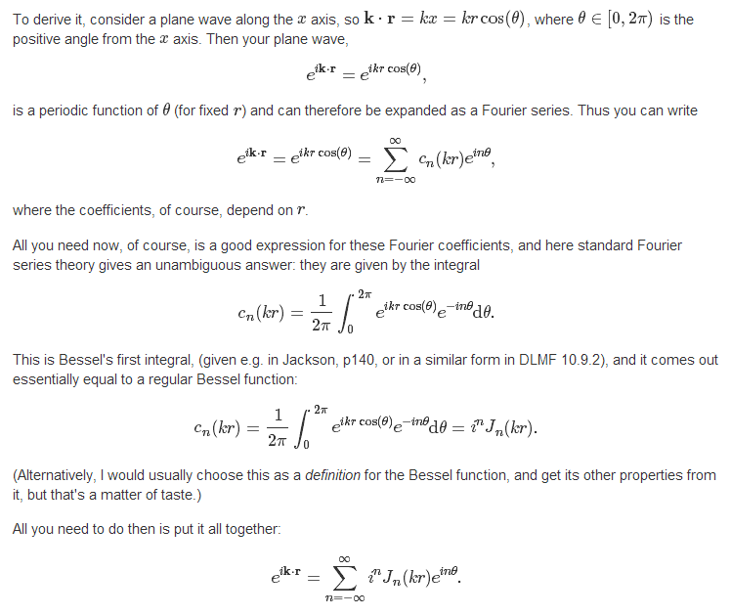
http://physics.stackexchange.com/questions/44761/plane-wave-expansion-in-cylindrical-coordinates

Slide 7
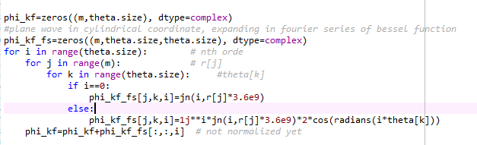
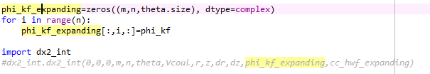

Slide 8
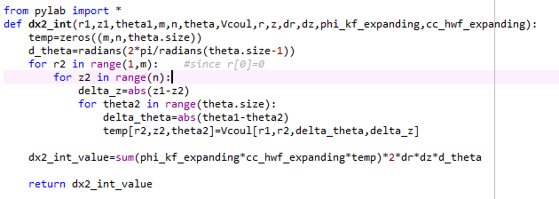
Make it 3dimension matrix
0 ~ π이므로

